Slide 1
Image Processing with Deep Learning
Michael Yuhas, Ph.D. Candidate - ERI@N
February 21st, 2025
Open
michael.yuhas@ntu.edu.sg
https://www.ntu.edu.sg/erian

Slide 2
Agenda
Time | Item
2:00-2:15 | Introduction to Convolution
2:15-2:45 | Convolutional Neural Networks (CNNs)
2:45-3:15 | Classification with CNNs
3:15-3:30 | Break

Slide 3
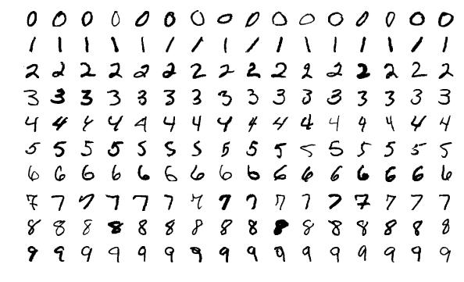
A Real-World Problem...
Imagine you run a post office
All letters have a 5-digit zip code for routing
You receive millions of letters and packages a day and need to decide where to send them
Human labor is costly and time consuming
How can you automate this task?
Examples of handwritten Arabic numerals from 1000 different writers [1]
[1] Y. Lecun, L. Bottou, Y. Bengio and P. Haffner, "Gradient-based learning applied to document recognition," in Proceedings of the IEEE, vol. 86, no. 11, pp. 2278-2324, Nov. 1998.

Slide 4
A Real-World Problem...
This was the problem facing the USPS in 1989
How would you solve this problem?
Examples of handwritten Arabic numerals from 1000 different writers [1]
[1] Y. Lecun, L. Bottou, Y. Bengio and P. Haffner, "Gradient-based learning applied to document recognition," in Proceedings of the IEEE, vol. 86, no. 11, pp. 2278-2324, Nov. 1998.

Slide 5
Introduction To Convolution

Slide 6
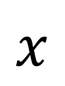
Convolution
0
1
5
1
0
An image is represented as a matrix of numbers
Higher Value = More intensity
0
5
0
5
0
0
5
5
5
0
$$x$$
0
5
0
5
0
1
5
0
5
1

Slide 7
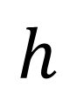
Convolution
0
1
5
1
0
An image is represented as a matrix of numbers
Higher Value = More intensity
A kernel is also a matrix containing some pattern
0
5
0
5
0
0
5
5
5
0
$$x$$
0
5
0
5
0
1
5
0
5
1
0
1
2
$$h$$
2
2
0
0
1
2

Slide 8
Convolution
0
1
5
1
0
An image is represented as a matrix of numbers
Higher Value = More intensity
A kernel is also a matrix containing some pattern
0
5
0
5
0
0
5
5
5
0
0
5
0
5
0
1
5
0
5
1
0
1
2
2
2
0
0
1
2

Slide 9
Convolution
0 x 0
1 x 1
2 x 5
1
0
An image is represented as a matrix of numbers
Higher Value = More intensity
A kernel is also a matrix containing some pattern
Slide a kernel along an image, multiply overlapping values, and sum the result
2 x 0
2 x 5
0 x 0
5
0
0 x 0
1 x 5
2 x 5
5
0
0
5
0
5
0
1
5
0
5
1

Slide 10
Convolution
0 x 0
1 x 1
2 x 5
1
0
+0
An image is represented as a matrix of numbers
Higher Value = More intensity
A kernel is also a matrix containing some pattern
Slide a kernel along an image, multiply overlapping values, and sum the result
2 x 0
2 x 5
0 x 0
5
0
0 x 0
1 x 5
2 x 5
5
0
0
5
0
5
0
1
5
0
5
1
0

Slide 11
Convolution
0 x 0
1 x 1
2 x 5
1
0
+1
An image is represented as a matrix of numbers
Higher Value = More intensity
A kernel is also a matrix containing some pattern
Slide a kernel along an image, multiply overlapping values, and sum the result
2 x 0
2 x 5
0 x 0
5
0
0 x 0
1 x 5
2 x 5
5
0
0
5
0
5
0
1
5
0
5
1
1

Slide 12
Convolution
0 x 0
1 x 1
2 x 5
1
0
+10
An image is represented as a matrix of numbers
Higher Value = More intensity
A kernel is also a matrix containing some pattern
Slide a kernel along an image, multiply overlapping values, and sum the result
2 x 0
2 x 5
0 x 0
5
0
0 x 0
1 x 5
2 x 5
5
0
0
5
0
5
0
1
5
0
5
1
11

Slide 13
Convolution
0 x 0
1 x 1
2 x 5
1
0
An image is represented as a matrix of numbers
Higher Value = More intensity
A kernel is also a matrix containing some pattern
Slide a kernel along an image, multiply overlapping values, and sum the result
2 x 0
2 x 5
0 x 0
5
0
+0
0 x 0
1 x 5
2 x 5
5
0
0
5
0
5
0
1
5
0
5
1
11

Slide 14
Convolution
0 x 0
1 x 1
2 x 5
1
0
An image is represented as a matrix of numbers
Higher Value = More intensity
A kernel is also a matrix containing some pattern
Slide a kernel along an image, multiply overlapping values, and sum the result
2 x 0
2 x 5
0 x 0
5
0
+10
0 x 0
1 x 5
2 x 5
5
0
0
5
0
5
0
1
5
0
5
1
21

Slide 15
Convolution
0 x 0
1 x 1
2 x 5
1
0
An image is represented as a matrix of numbers
Higher Value = More intensity
A kernel is also a matrix containing some pattern
Slide a kernel along an image, multiply overlapping values, and sum the result
2 x 0
2 x 5
0 x 0
5
0
+0
0 x 0
1 x 5
2 x 5
5
0
0
5
0
5
0
1
5
0
5
1
21

Slide 16
Convolution
0 x 0
1 x 1
2 x 5
1
0
An image is represented as a matrix of numbers
Higher Value = More intensity
A kernel is also a matrix containing some pattern
Slide a kernel along an image, multiply overlapping values, and sum the result
2 x 0
2 x 5
0 x 0
5
0
+0
0 x 0
1 x 5
2 x 5
5
0
0
5
0
5
0
1
5
0
5
1
21

Slide 17
Convolution
0 x 0
1 x 1
2 x 5
1
0
An image is represented as a matrix of numbers
Higher Value = More intensity
A kernel is also a matrix containing some pattern
Slide a kernel along an image, multiply overlapping values, and sum the result
2 x 0
2 x 5
0 x 0
5
0
+5
0 x 0
1 x 5
2 x 5
5
0
0
5
0
5
0
1
5
0
5
1
26

Slide 18
Convolution
0 x 0
1 x 1
2 x 5
1
0
An image is represented as a matrix of numbers
Higher Value = More intensity
A kernel is also a matrix containing some pattern
Slide a kernel along an image, multiply overlapping values, and sum the result
2 x 0
2 x 5
0 x 0
5
0
+10
0 x 0
1 x 5
2 x 5
5
0
0
5
0
5
0
1
5
0
5
1
36

Slide 19
Convolution
0 x 0
1 x 1
2 x 5
1
0
An image is represented as a matrix of numbers
Higher Value = More intensity
A kernel is also a matrix containing some pattern
Slide a kernel along an image, multiply overlapping values, and sum the result
2 x 0
2 x 5
0 x 0
5
0
0 x 0
1 x 5
2 x 5
5
0
0
5
0
5
0
1
5
0
5
1
36

Slide 20
Convolution
0
0 x 1
1 x 5
2 x 1
0
An image is represented as a matrix of numbers
Higher Value = More intensity
A kernel is also a matrix containing some pattern
Slide a kernel along an image, multiply overlapping values, and sum the result
0
2 x 5
2 x 0
0 x 5
0
0
0 x 5
1 x 5
2 x 5
0
0
5
0
5
0
1
5
0
5
1
36
0

Slide 21
Convolution
0
0 x 1
1 x 5
2 x 1
0
An image is represented as a matrix of numbers
Higher Value = More intensity
A kernel is also a matrix containing some pattern
Slide a kernel along an image, multiply overlapping values, and sum the result
0
2 x 5
2 x 0
0 x 5
0
+0
0
0 x 5
1 x 5
2 x 5
0
0
5
0
5
0
1
5
0
5
1
36
0

Slide 22
Convolution
0
0 x 1
1 x 5
2 x 1
0
An image is represented as a matrix of numbers
Higher Value = More intensity
A kernel is also a matrix containing some pattern
Slide a kernel along an image, multiply overlapping values, and sum the result
0
2 x 5
2 x 0
0 x 5
0
+5
0
0 x 5
1 x 5
2 x 5
0
0
5
0
5
0
1
5
0
5
1
36
5

Slide 23
Convolution
0
0 x 1
1 x 5
2 x 1
0
An image is represented as a matrix of numbers
Higher Value = More intensity
A kernel is also a matrix containing some pattern
Slide a kernel along an image, multiply overlapping values, and sum the result
0
2 x 5
2 x 0
0 x 5
0
+2
0
0 x 5
1 x 5
2 x 5
0
0
5
0
5
0
1
5
0
5
1
36
7

Slide 24
Convolution
0
0 x 1
1 x 5
2 x 1
0
An image is represented as a matrix of numbers
Higher Value = More intensity
A kernel is also a matrix containing some pattern
Slide a kernel along an image, multiply overlapping values, and sum the result
0
2 x 5
2 x 0
0 x 5
0
+10
0
0 x 5
1 x 5
2 x 5
0
0
5
0
5
0
1
5
0
5
1
36
17

Slide 25
Convolution
0
0 x 1
1 x 5
2 x 1
0
An image is represented as a matrix of numbers
Higher Value = More intensity
A kernel is also a matrix containing some pattern
Slide a kernel along an image, multiply overlapping values, and sum the result
0
2 x 5
2 x 0
0 x 5
0
0
0 x 5
1 x 5
2 x 5
0
0
5
0
5
0
1
5
0
5
1
36
17

Slide 26
Convolution
0
0 x 1
1 x 5
2 x 1
0
An image is represented as a matrix of numbers
Higher Value = More intensity
A kernel is also a matrix containing some pattern
Slide a kernel along an image, multiply overlapping values, and sum the result
0
2 x 5
2 x 0
0 x 5
0
0
0 x 5
1 x 5
2 x 5
0
0
5
0
5
0
1
5
0
5
1
36
17

Slide 27
Convolution
0
0 x 1
1 x 5
2 x 1
0
An image is represented as a matrix of numbers
Higher Value = More intensity
A kernel is also a matrix containing some pattern
Slide a kernel along an image, multiply overlapping values, and sum the result
0
2 x 5
2 x 0
0 x 5
0
0
0 x 5
1 x 5
2 x 5
0
0
5
0
5
0
1
5
0
5
1
36
17

Slide 28
Convolution
0
0 x 1
1 x 5
2 x 1
0
An image is represented as a matrix of numbers
Higher Value = More intensity
A kernel is also a matrix containing some pattern
Slide a kernel along an image, multiply overlapping values, and sum the result
0
2 x 5
2 x 0
0 x 5
0
+5
0
0 x 5
1 x 5
2 x 5
0
0
5
0
5
0
1
5
0
5
1
36
22

Slide 29
Convolution
0
0 x 1
1 x 5
2 x 1
0
An image is represented as a matrix of numbers
Higher Value = More intensity
A kernel is also a matrix containing some pattern
Slide a kernel along an image, multiply overlapping values, and sum the result
0
2 x 5
2 x 0
0 x 5
0
+10
0
0 x 5
1 x 5
2 x 5
0
0
5
0
5
0
1
5
0
5
1
36
32

Slide 30
Convolution
0
1
0 x 5
1 x 1
2 x 0
An image is represented as a matrix of numbers
Higher Value = More intensity
A kernel is also a matrix containing some pattern
Slide a kernel along an image, multiply overlapping values, and sum the result
0
5
2 x 0
2 x 5
0 x 0
0
5
0 x 5
1 x 5
2 x 0
0
5
0
5
0
1
5
0
5
1
36
32

Slide 31
Convolution
0
1
0 x 5
1 x 1
2 x 0
An image is represented as a matrix of numbers
Higher Value = More intensity
A kernel is also a matrix containing some pattern
Slide a kernel along an image, multiply overlapping values, and sum the result
0
5
2 x 0
2 x 5
0 x 0
0
5
0 x 5
1 x 5
2 x 0
0
5
0
5
0
1
5
0
5
1
36
32
16

Slide 32
Convolution
0
1
5
1
0
An image is represented as a matrix of numbers
Higher Value = More intensity
A kernel is also a matrix containing some pattern
Slide a kernel along an image, multiply overlapping values, and sum the result
0 x 0
1 x 5
2 x 0
5
0
2 x 0
2 x 5
0 x 5
5
0
0 x 0
1 x 5
2 x 0
5
0
1
5
0
5
1
36
32
16

Slide 33
Convolution
0
1
5
1
0
An image is represented as a matrix of numbers
Higher Value = More intensity
A kernel is also a matrix containing some pattern
Slide a kernel along an image, multiply overlapping values, and sum the result
0 x 0
1 x 5
2 x 0
5
0
2 x 0
2 x 5
0 x 5
5
0
0 x 0
1 x 5
2 x 0
5
0
1
5
0
5
1
36
32
16
20

Slide 34
Convolution
0
1
5
1
0
An image is represented as a matrix of numbers
Higher Value = More intensity
A kernel is also a matrix containing some pattern
Slide a kernel along an image, multiply overlapping values, and sum the result
0
0 x 5
1 x 0
2 x 5
0
0
2 x 5
2 x 5
0 x 5
0
0
0 x 5
1 x 0
2 x 5
0
1
5
0
5
1
36
32
16
20

Slide 35
Convolution
0
1
5
1
0
An image is represented as a matrix of numbers
Higher Value = More intensity
A kernel is also a matrix containing some pattern
Slide a kernel along an image, multiply overlapping values, and sum the result
0
0 x 5
1 x 0
2 x 5
0
0
2 x 5
2 x 5
0 x 5
0
0
0 x 5
1 x 0
2 x 5
0
1
5
0
5
1
36
32
16
20
40

Slide 36
Convolution
0
1
5
1
0
An image is represented as a matrix of numbers
Higher Value = More intensity
A kernel is also a matrix containing some pattern
Slide a kernel along an image, multiply overlapping values, and sum the result
0
5
0 x 0
1 x 5
2 x 0
0
5
2 x 5
2 x 5
0 x 0
0
5
0 x 0
1 x 5
2 x 0
1
5
0
5
1
36
32
16
20
40

Slide 37
Convolution
0
1
5
1
0
An image is represented as a matrix of numbers
Higher Value = More intensity
A kernel is also a matrix containing some pattern
Slide a kernel along an image, multiply overlapping values, and sum the result
0
5
0 x 0
1 x 5
2 x 0
0
5
2 x 5
2 x 5
0 x 0
0
5
0 x 0
1 x 5
2 x 0
1
5
0
5
1
36
32
16
20
40
30

Slide 38
Convolution
0
1
5
1
0
An image is represented as a matrix of numbers
Higher Value = More intensity
A kernel is also a matrix containing some pattern
Slide a kernel along an image, multiply overlapping values, and sum the result
0
5
0
5
0
0 x 0
1 x 5
2 x 5
5
0
2 x 0
2 x 5
0 x 0
5
0
0 x 1
1 x 5
2 x 0
5
1
36
32
16
20
40
30

Slide 39
Convolution
0
1
5
1
0
An image is represented as a matrix of numbers
Higher Value = More intensity
A kernel is also a matrix containing some pattern
Slide a kernel along an image, multiply overlapping values, and sum the result
0
5
0
5
0
0 x 0
1 x 5
2 x 5
5
0
2 x 0
2 x 5
0 x 0
5
0
0 x 1
1 x 5
2 x 0
5
1
36
32
16
20
40
30
30

Slide 40
Convolution
0
1
5
1
0
An image is represented as a matrix of numbers
Higher Value = More intensity
A kernel is also a matrix containing some pattern
Slide a kernel along an image, multiply overlapping values, and sum the result
0
5
0
5
0
0
0 x 5
1 x 5
2 x 5
0
0
2 x 5
2 x 0
0 x 5
0
1
0 x 5
1 x 0
2 x 5
1
36
32
16
20
40
30
30

Slide 41
Convolution
0
1
5
1
0
An image is represented as a matrix of numbers
Higher Value = More intensity
A kernel is also a matrix containing some pattern
Slide a kernel along an image, multiply overlapping values, and sum the result
0
5
0
5
0
0
0 x 5
1 x 5
2 x 5
0
0
2 x 5
2 x 0
0 x 5
0
1
0 x 5
1 x 0
2 x 5
1
36
32
16
20
40
30
30
35

Slide 42
Convolution
0
1
5
1
0
An image is represented as a matrix of numbers
Higher Value = More intensity
A kernel is also a matrix containing some pattern
Slide a kernel along an image, multiply overlapping values, and sum the result
0
5
0
5
0
0
5
0 x 5
1 x 5
2 x 0
0
5
2 x 0
2 x 5
0 x 0
1
5
0 x 0
1 x 5
2 x 1
36
32
16
20
40
30
30
35

Slide 43
Convolution
So What?
0
1
5
1
0
An image is represented as a matrix of numbers
Higher Value = More intensity
A kernel is also a matrix containing some pattern
Slide a kernel along an image, multiply overlapping values, and sum the result
0
5
0
5
0
0
5
0 x 5
1 x 5
2 x 0
0
5
2 x 0
2 x 5
0 x 0
1
5
0 x 0
1 x 5
2 x 1
36
32
16
20
40
30
30
35
22

Slide 44
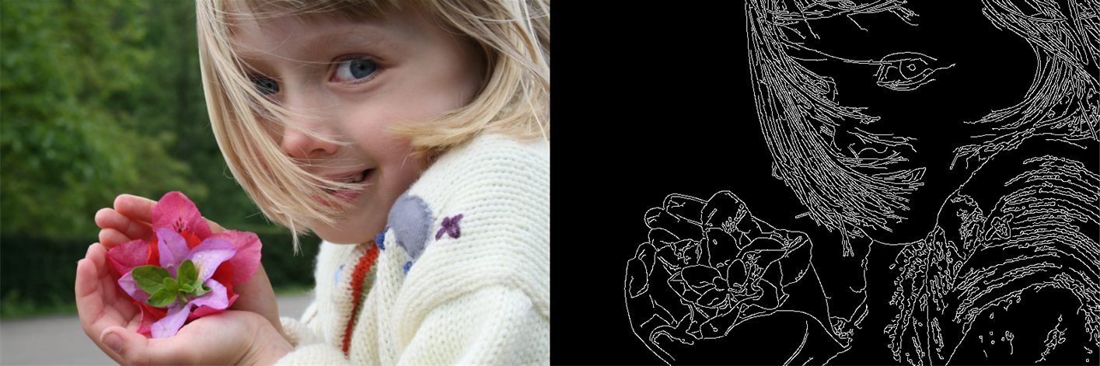
Edge Detection
Useful to segment an image
Sobel kernel – a special kernel used for edge detection
Value is high when the gradient is high in one direction
Thought Experiment - what happens when the Sobel kernel is convolved with:
[2] J. McLoone, Edge Detection Applied to a Photograph, Jun. 2010.
-1
0
1
0
5
5
5
5
5
-2
0
2
0
5
5
5
5
5
-1
0
1
0
5
5
5
5
5
Sobel Kernel
An Edge?
A Solid Color?

Slide 45
Image Classification With CNNS

Slide 46
Learnable Filters
-1
0
1
What if we were able to learn kernel weights instead of crafting them ourselves?
-2
0
2
-1
0
1

Slide 47
Learnable Filters
w_{0,0}
w_{1,0}
w_{2,0}
What if we were able to learn kernel weights instead of crafting them ourselves?
w_{0,1}
w_{1,1}
w_{2,1}
w_{0,2}
w_{1,2}
w_{2,2}

Slide 48
Learnable Filters
w_{0,1}
w_{0,0}
w_{1,0}
x_{2,0}
w_{2,0}
What if we were able to learn kernel weights instead of crafting them ourselves?
This pattern, summing the multiplication of weights is the same thing that happens in a neural network
x_{1,1}
w_{1,1}
x_{2,1}
w_{2,1}
Σ
x_{0,2}
w_{0,2}
x_{1,2}
w_{1,2}
x_{2,2}
w_{2,2}

Slide 49
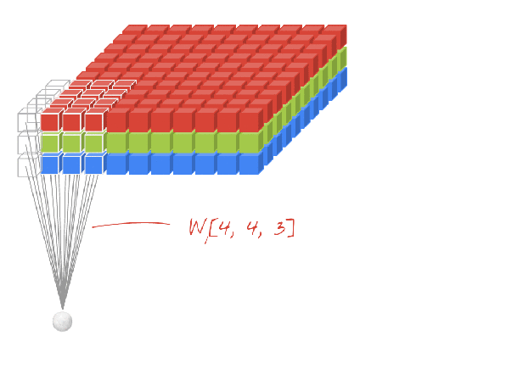
Learnable Filters
w_{0,1}
w_{0,0}
w_{1,0}
x_{2,0}
w_{2,0}
What if we were able to learn kernel weights instead of crafting them ourselves?
This pattern, summing the multiplication of weights is the same thing that happens in a neural network
Not just limited to three color channels
x_{1,1}
w_{1,1}
x_{2,1}
w_{2,1}
Σ
x_{0,2}
w_{0,2}
x_{1,2}
w_{1,2}
x_{2,2}
w_{2,2}
[3] M. Görner, 2D Conv with 3D Inputs, 2017

Slide 50
Padding
https://ezyang.github.io/convolution-visualizer/
Reasons to pad:
Information loss at edges of image
Need to match output dimensions
Types of padding:
0’s
1’s
Reflective

Slide 51

Stride
https://ezyang.github.io/convolution-visualizer/
Skip pixels while dragging the kernel
A higher stride let’s us…
Process data faster
Reduce dimensionality
At the expense of…
Ignoring some information in the input
[4] Intuitively Understanding Deep Convolution, Towards Data Science (2018)

Slide 52
Dilation
https://ezyang.github.io/convolution-visualizer/
Increase the receptive field of a neuron without increasing the number of computations

Slide 53
Dilation
https://ezyang.github.io/convolution-visualizer/
Increase the receptive field of a neuron without increasing the number of computations

Slide 54
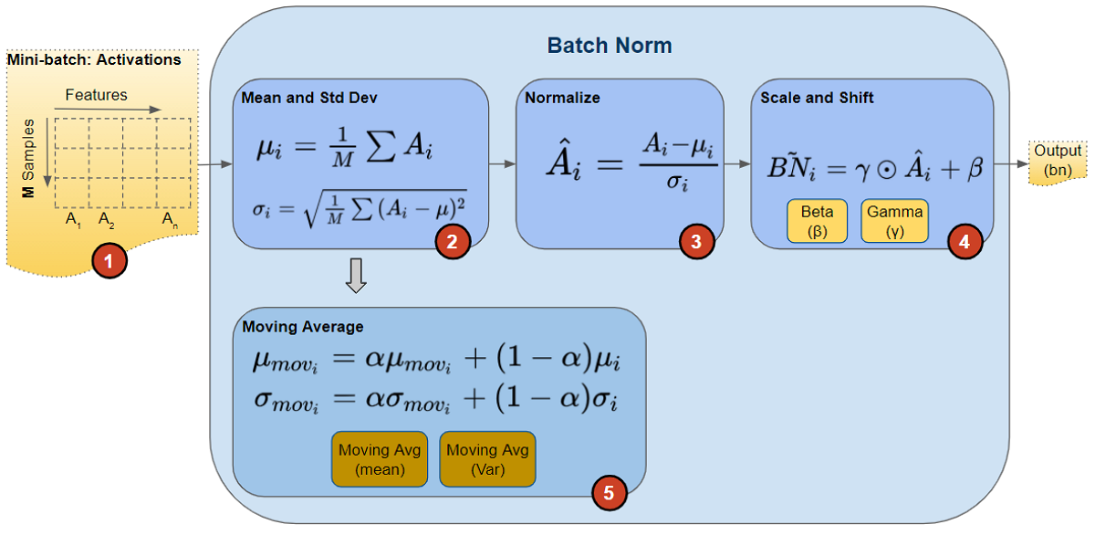
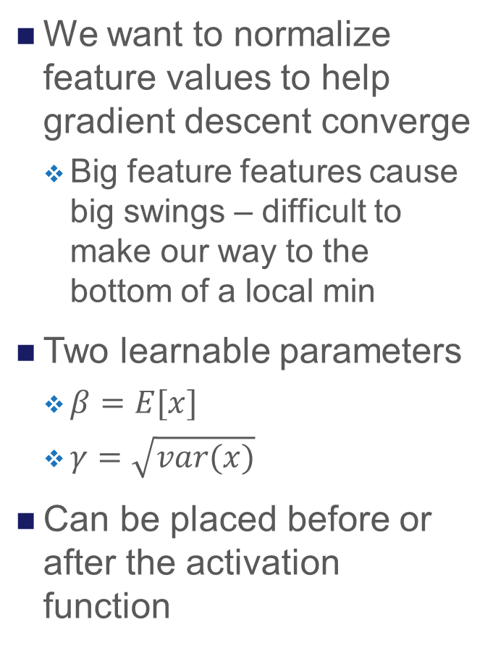
Normalization
We want to normalize feature values to help gradient descent converge
Big feature features cause big swings – difficult to make our way to the bottom of a local min
Two learnable parameters
$β=E[x]$
$γ=\sqrt{var(x)}$
Can be placed before or after the activation function
[5] K. Doshi, Batch Norm Explained Visually, Towards Data Science (2021)

Slide 55
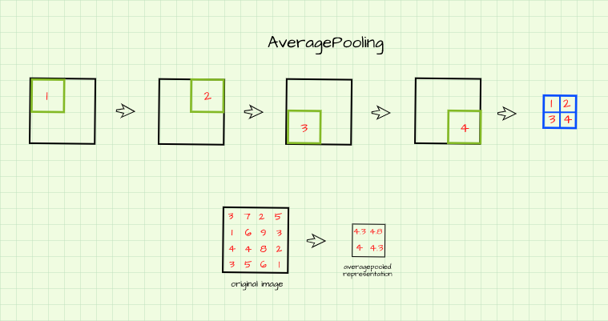
Pooling
Sometimes we want to reduce dimensionality without learning any new parameters
Speed up inference by reducing computation cost
Types:
Average
Max
Min
[6] O. Olu-Ipinlaye, Pooling in Convolutional Neural Networks, PaperSpace (2023)

Slide 56

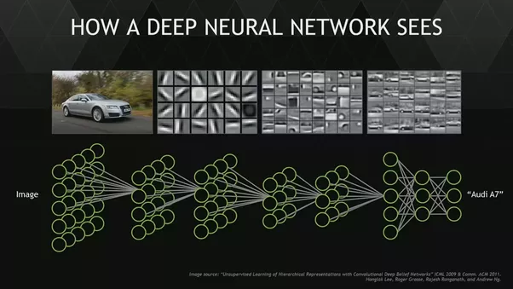
Adding Depth
In shallow networks we learn a function that maps a feature space to an output
In deep learning, we don’t know the features, so we use a convolutional layer to learn them
Repeat ad infinitum
Usually early layers find simple patterns like edges while later layers learn more complex concepts
[7] S. N. Gupta, Deep Convolutional Neural Networks Explained in Layman’s Terms, Medium (2022).

Slide 57
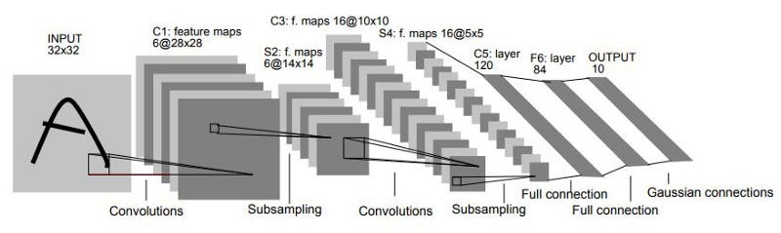
LeNet
Invented by Yann LeCun in 1989 to classify postcode digits
2 convolutional layers followed by 2 fully connected layers
Input: 28x28 greyscale image
Surprisingly powerful (can use this to make a car follow lanes)
LeNet 5 Architecture [1]
[1] Y. Lecun, L. Bottou, Y. Bengio and P. Haffner, "Gradient-based learning applied to document recognition," in Proceedings of the IEEE, vol. 86, no. 11, pp. 2278-2324, Nov. 1998.

Slide 58
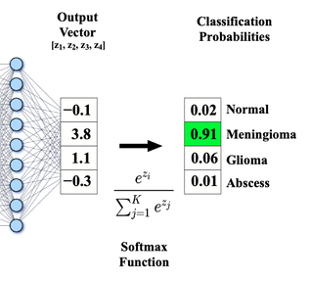
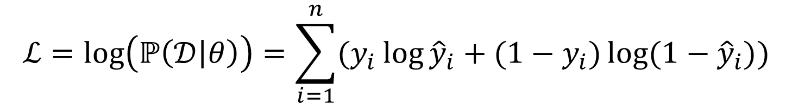
NLLLoss and Softmax
[9] Questions and Answers in MRI
Sometimes we want to know not just which class is most likely, but what is its probability
With this probability value, Softmax let’s us create a loss function based on probability
We take the log of the probability to make this play nicely with optimizers (like Adam)
$$ℒ=\log\left(ℙ\left(𝒟 | θ\right)\right)=\sum_{i=1}^{n}{(y_{i}\log{{\hat{y}}_{i}}+{(1−y}_{i})\log{{(1−\hat{y}}_{i})})}$$

Slide 59
Exercise 2: Image Classification
Now let’s put everything we learned into practice…
Can you solve the character recognition problem?
Examples of handwritten Arabic numerals from 1000 different writers [1]
[1] Y. Lecun, L. Bottou, Y. Bengio and P. Haffner, "Gradient-based learning applied to document recognition," in Proceedings of the IEEE, vol. 86, no. 11, pp. 2278-2324, Nov. 1998.

Slide 60
Break TIme

Slide 61
https://www.ntu.edu.sg/erian

